Slide 1
STACKS
Lecture # 7

Slide 2
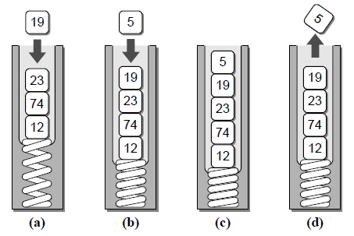
Introduction
Stack is used to store data such that the last item inserted is the first item removed.
It is used to implement a last-in first-out (LIFO) type protocol.
The stack is a linear data structure in which new items are added, or existing items are removed from the same end, commonly referred to as the top of the stack.

Slide 3
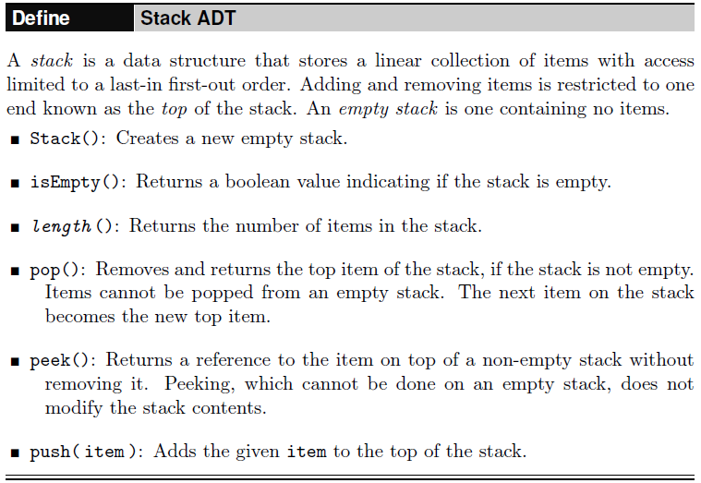
STACK ADT

Slide 4
Implementing the Stack
The two most common approaches in Python to implement stacks,
Using a Python list
Using a linked list.

Slide 5
Implementing the Stack - Using a Python List
The Python list-based implementation of the Stack ADT is the easiest to implement.
The end of the list represent the top of the stack and the front represent the base.
As the stack grows, items are appended to the end of the list and when items are popped, they are removed from the same end.
The peek() and pop() operations can only be used with a non-empty stack since you cannot remove or peek at something that is not there.
The peek() method simply returns a reference to the last item in the list.

Slide 6
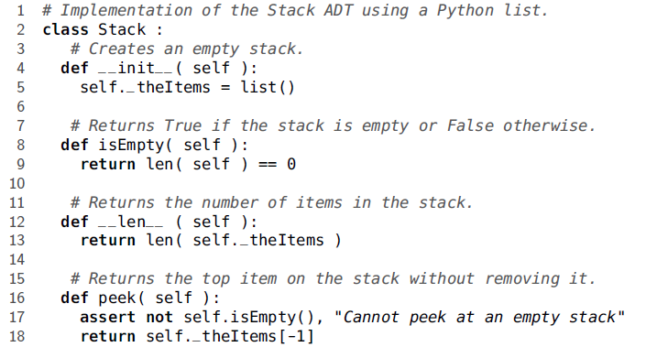
Implementing the Stack - Using a Python List

Slide 7
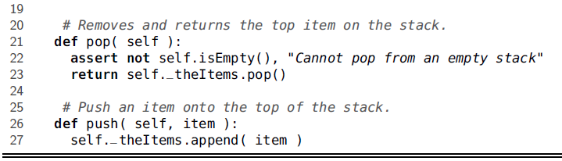
Implementing the Stack - Using a Python List

Slide 8
Implementing the Stack - Using a Linked List

Slide 9
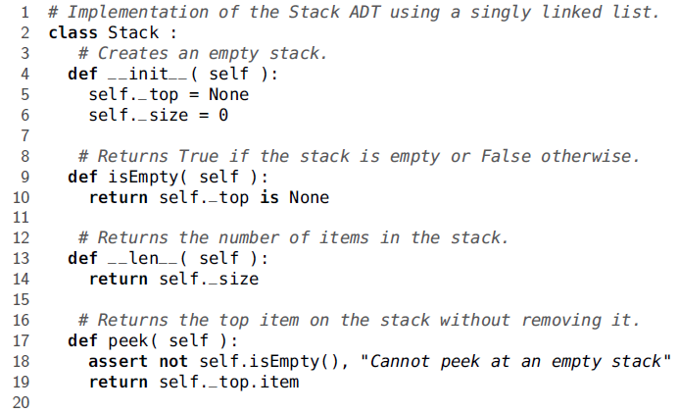
Implementing the Stack - Using a Linked List

Slide 10
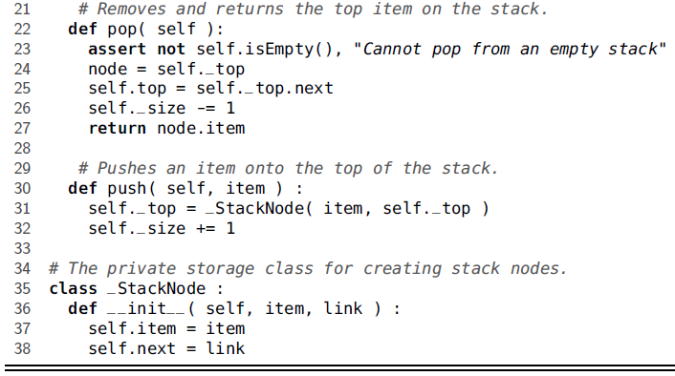
Implementing the Stack - Using a Linked List

Slide 11

Stack Applications - Balanced Delimiters
A number of applications use delimiters to group strings of text or simple data into subparts by marking the beginning and end of the group.
Some common examples include mathematical expressions, programming languages, and the HTML markup language used by web browsers.
Parentheses can be used in mathematical expressions to group or override the order of precedence for various operations.
To aide in reading complicated expressions, the writer may choose to use different types of symbol pairs, as illustrated here:
$$\{A+(B∗C)−(D/[E+F] ) \}$$

Slide 12
Stack Applications - Balanced Delimiters
\\ C++ code for sum of integers
int sumList( int theList[], int size )
{
int sum = 0;
int i = 0;
while( i < size ) {
sum += theList[ i ];
i += 1;
}
return sum;
}

Slide 13
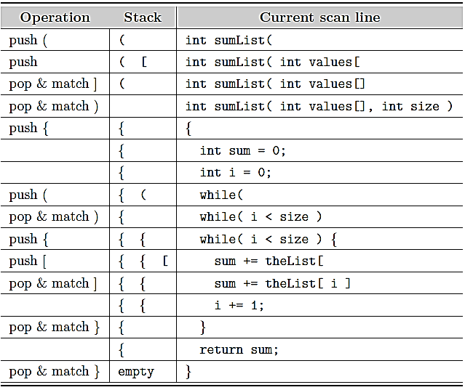
Stack Applications - Balanced Delimiters

Slide 14
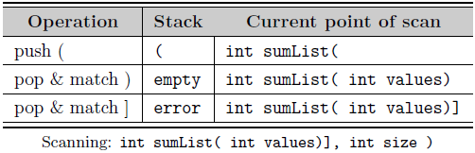
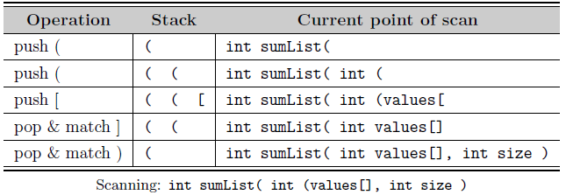
Stack Applications - Balanced Delimiters

Slide 15
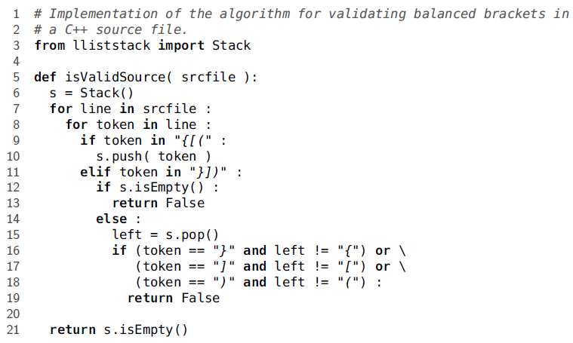
Stack Applications - Balanced Delimiters

Slide 16
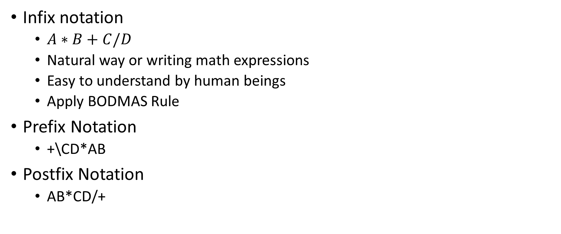
Evaluating Postfix Expressions
Infix notation
$A∗B+C/D$
Natural way or writing math expressions
Easy to understand by human beings
Apply BODMAS Rule
Prefix Notation
+\CD*AB
Postfix Notation
AB*CD/+

Slide 17
Converting from Infix to Postfix
Scan input string from left to right character by character.
If the character is an operand, put it into output stack.
If the character is an operator and operator's stack is empty, push operator into operators' stack.
If the operator's stack is not empty, there may be following possibilities.
If the precedence of scanned operator is greater than the topmost operator of operator's stack, push this operator into operand's stack.
If the precedence of scanned operator is less than or equal to the topmost operator of operator's stack, pop the operators from operand's stack until we find a low precedence operator than the scanned character. Never pop out ( '(' ) or ( ')' ) whatever may be the precedence level of scanned character.
If the character is opening round bracket ( '(' ), push it into operator's stack.
If the character is closing round bracket ( ')' ), pop out operators from operator's stack until we find an opening bracket ('(' ).
Now pop out all the remaining operators from the operator's stack and push into output stack.

Slide 18
Converting from Infix to Postfix
Scan Sequence | Input String | Output Stack | Operator Stack
1 | A+B*C/(E-F) | A
2 | A+B*C/(E-F) | A | +
3 | A+B*C/(E-F) | AB | +
4 | A+B*C/(E-F) | AB | +*
5 | A+B*C/(E-F) | ABC | +*
6 | A+B*C/(E-F) | ABC* | +/
7 | A+B*C/(E-F) | ABC* | +/(
8 | A+B*C/(E-F) | ABC*E | +/(
9 | A+B*C/(E-F) | ABC*E | +/(-
10 | A+B*C/(E-F) | ABC*EF | +/(-
11 | A+B*C/(E-F) | ABC*EF- | +/
12 | A+B*C/(E-F) | ABC*EF-/+

Slide 19
Converting from Infix to Postfix
from Chapter7.lliststack import Stack def infixToPostfix(infixexpr): prec = {"*":3,"/":3,"+":2,"-":2,"(":1} opStack = Stack() # Operator stack postfixList = [] # output stack tokenList = infixexpr.split() for token in tokenList: if token in "ABCDEFGHIJKLMNOPQRSTUVWXYZ" or token in "0123456789": postfixList.append(token) elif token == '(': opStack.push(token) elif token == ')': topToken = opStack.pop() while topToken != '(': postfixList.append(topToken) topToken = opStack.pop() | else: while (not opStack.isEmpty()) and (prec[opStack.peek()] >= prec[token]): postfixList.append(opStack.pop()) opStack.push(token) while not opStack.isEmpty(): postfixList.append(opStack.pop()) return " ".join(postfixList)

Slide 20
Postfix Evaluation Algorithm
If the current item is an operand, push its value onto the stack.
If the current item is an operator:
Pop the top two operands off the stack.
Perform the operation. (Note the top value is the right operand while the next to the top value is the left operand.)
Push the result of this operation back onto the stack.

Slide 21
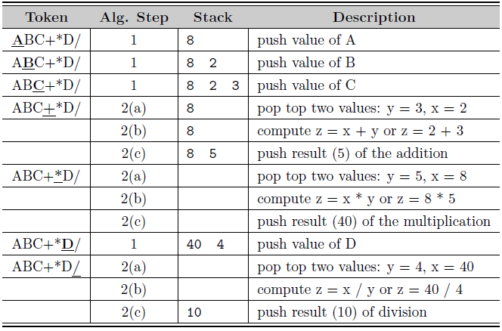
Postfix Evaluation Algorithm

Slide 22
A=8, B=2, C=5, D=4, E=3, F=1
Token | Alg. Steps | Stack | Description
ABC*EF-/+ | 1 | 8 | Push Value of A
ABC*EF-/+ | 2 | 8 2 | Push Value of B
ABC*EF-/+ | 3 | 8 2 5 | Push Value of C
ABC*EF-/+ | 4 | 8 10 | B x C
ABC*EF-/+ | 5 | 8 10 3 | Push Value of E
ABC*EF-/+ | 6 | 8 10 3 1 | Push Value of F
ABC*EF-/+ | 7 | 8 10 2 | E-F
ABC*EF-/+ | 8 | 8 5 | (BxC)/(E-F)
ABC*EF-/+ | 9 | 13 | A+((BxC)/(E-F))

Slide 23
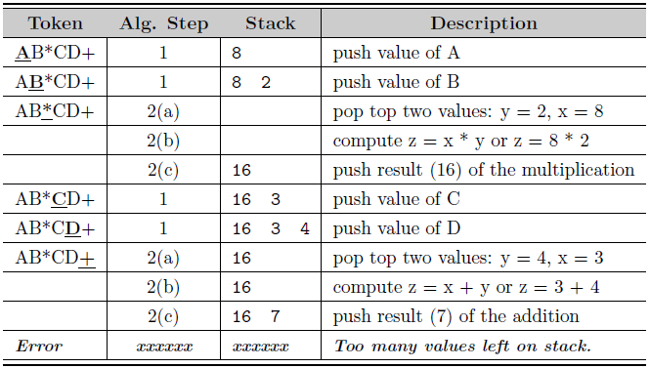
Postfix Evaluation Algorithm

Slide 24
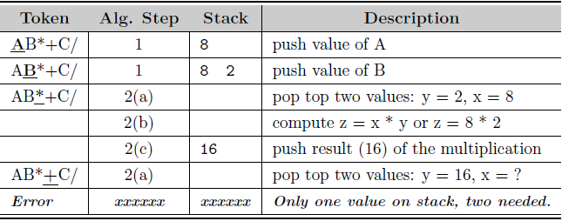
Postfix Evaluation Algorithm

Slide 25
Postfix Evaluation Algorithm
from Chapter7.lliststack import Stack from infix2postfix import infixToPostfix def evaluatePostfix(e): size = len(e) a = 0 b = 0 s = Stack() isVaild = True i = 0 while (i < size and isVaild): if (e[i] >= '0' and e[i] <= '9'): a = ord(e[i]) - ord('0') s.push(a) elif (len(s) > 1): a = s.pop() b = s.pop() | if (e[i] == '+'): s.push(b + a) elif (e[i] == '-'): s.push(b - a) elif (e[i] == '*'): s.push(b * a) elif (e[i] == '/'): s.push(int(b / a)) elif (e[i] == '%'): s.push(b % a) else: isVaild = False elif (len(s) == 1): if (e[i] == '-'): a = s.pop() s.push(-a) | elif (e[i] != '+'): # When not use +,- isVaild = False else: isVaild = False i += 1 if (isVaild == False): # Possible case use other operators # 1) When using special operators # 2) Or expression is invalid print(e, " Invalid expression ") return print(e, " = ", s.pop())

Slide 26
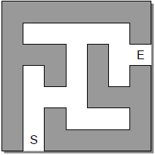
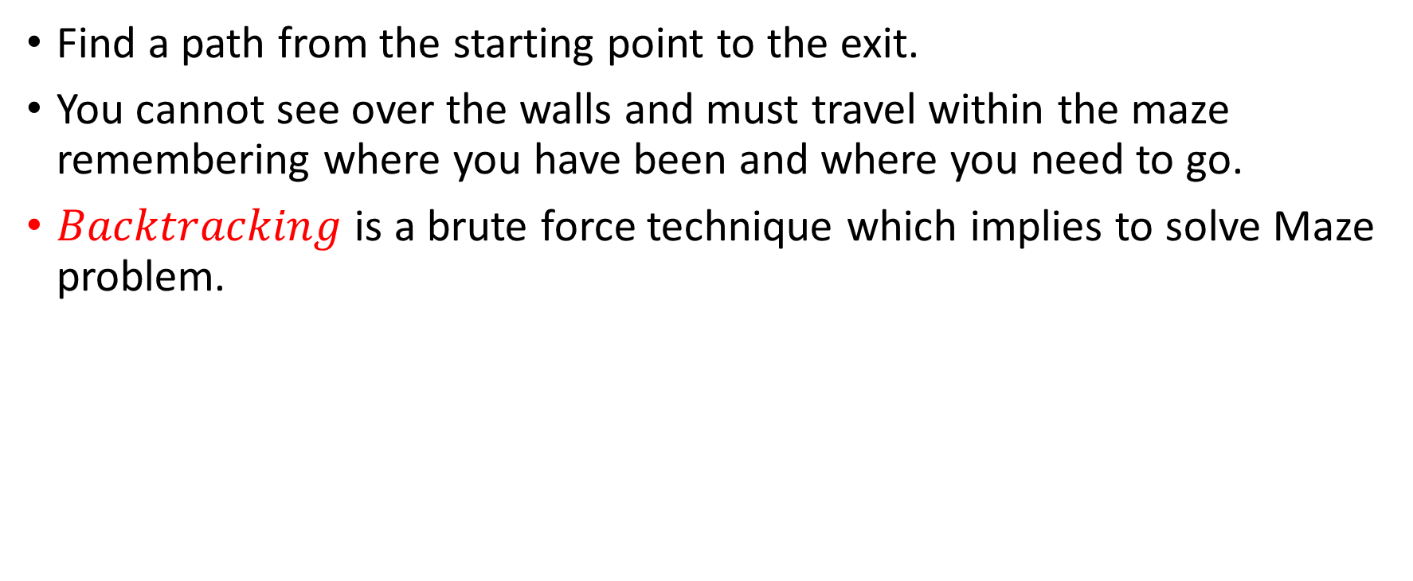
Application: Solving a Maze
Find a path from the starting point to the exit.
You cannot see over the walls and must travel within the maze remembering where you have been and where you need to go.
$Backtracking$ is a brute force technique which implies to solve Maze problem.

Slide 27
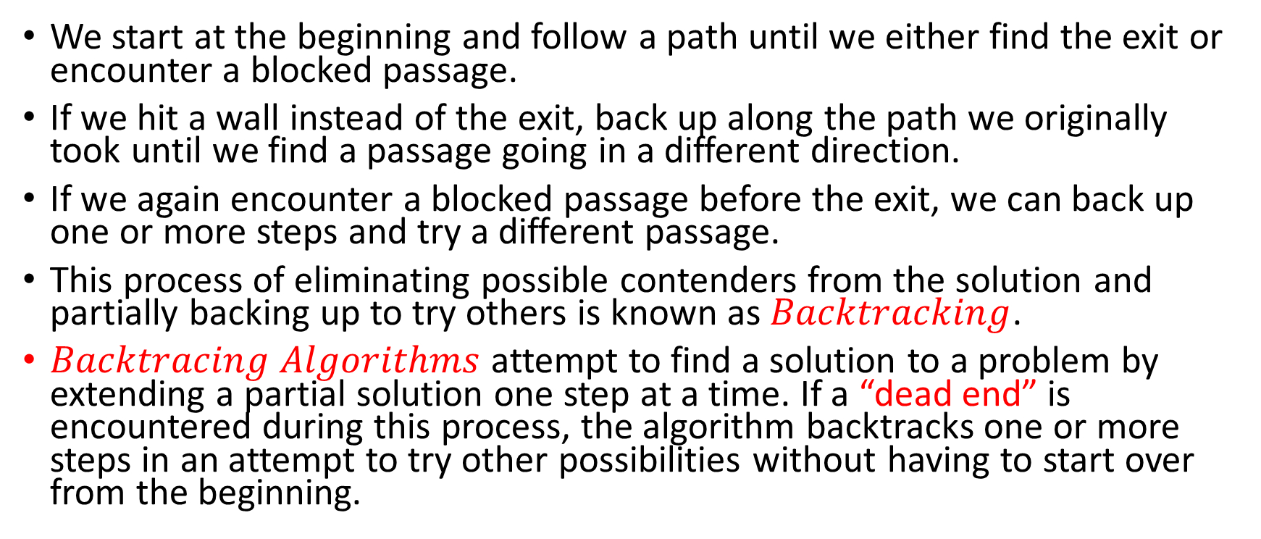
Solving Maze – Backtracking Algorithm
We start at the beginning and follow a path until we either find the exit or encounter a blocked passage.
If we hit a wall instead of the exit, back up along the path we originally took until we find a passage going in a different direction.
If we again encounter a blocked passage before the exit, we can back up one or more steps and try a different passage.
This process of eliminating possible contenders from the solution and partially backing up to try others is known as $Backtracking$.
$Backtracing Algorithms$ attempt to find a solution to a problem by extending a partial solution one step at a time. If a “dead end” is encountered during this process, the algorithm backtracks one or more steps in an attempt to try other possibilities without having to start over from the beginning.

Slide 28
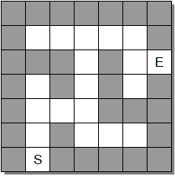
Solving Maze - Designing a Solution
Consider, maze is a collection of equal-sized cells laid out in rows and columns.
The cells will either be filled representing walls of the maze or empty to represent open spaces.
In addition, one cell will be indicated as the starting position (S) and another as the exit (E).

Slide 29
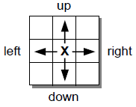
Solving Maze - Designing a Solution
One can only move one cell at a time and only to open positions, those not blocked by a wall or previously used along the current path.
Limit movement between opens cells to the horizontal and vertical directions - up, down, left, and right.
During our search for the exit, we need to remember which cells have been visited. Some will be part of the final path to the exit while others will have led us to dead ends.
At the end, we need to know which cells form the path from the start to the exit.
But during the search for the exit, we also need to avoid cells that previously led to a dead end.
To assist in remembering the cells, we can place a token in each cell visited and distinguish between the two.

Slide 30
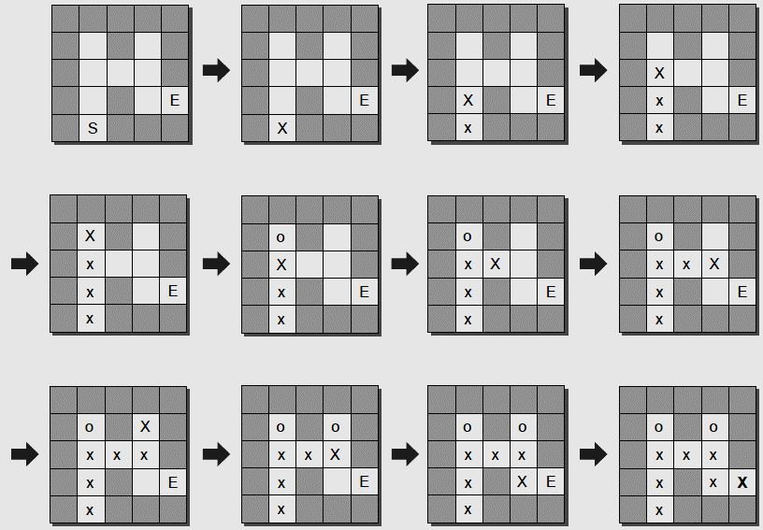
Solving Maze - Designing a Solution

Slide 31
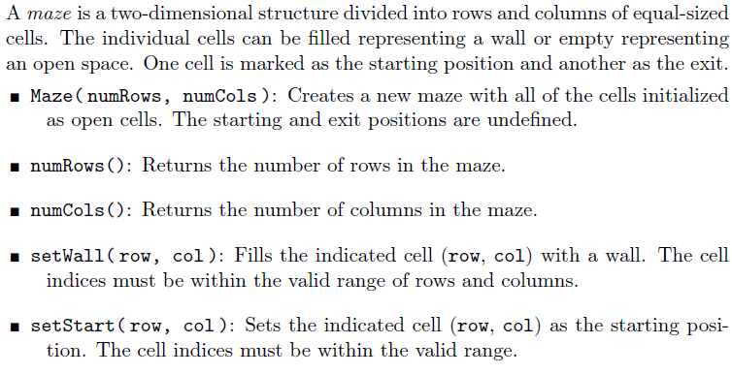
Maze - ADT

Slide 32
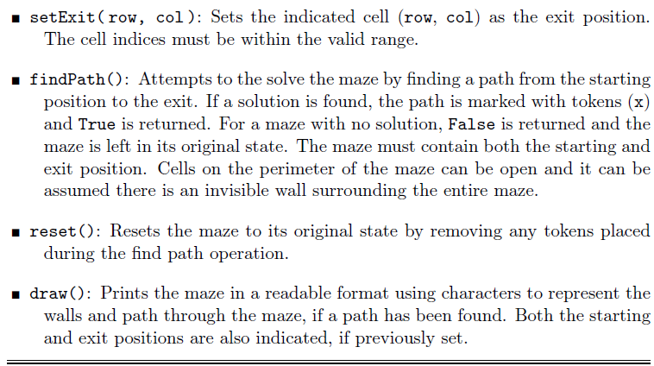
Maze - ADT

Slide 33
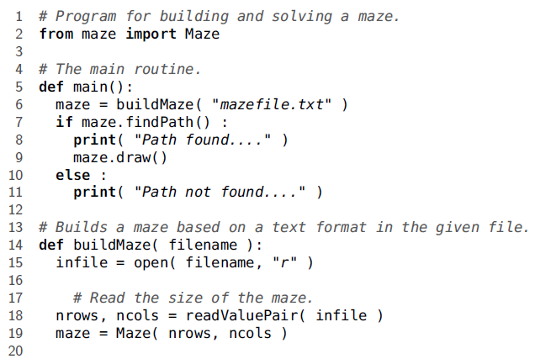
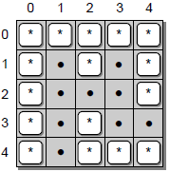
Maze - Code
5 5
4 1
3 4
*****
* * *
* *
* *
* ***
The first line contains the size of the maze given as the number of rows and columns.
The two subsequent lines indicate the row and column indices of the starting and exit positions.
The remaining lines of text represent the maze itself,
with walls represented using a asterisk symbol and open cells represented by blank spaces.

Slide 34
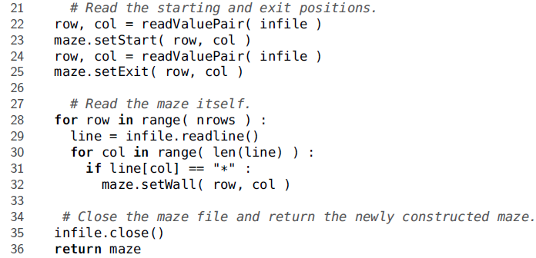
Maze - Code

Slide 35
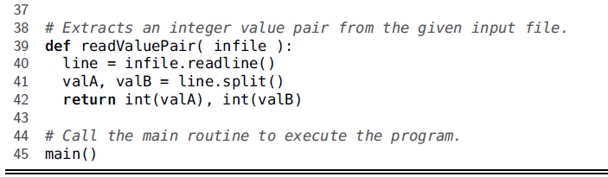
Maze - Code

Slide 36
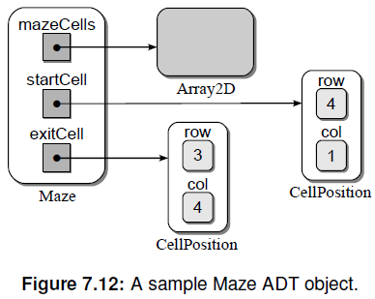
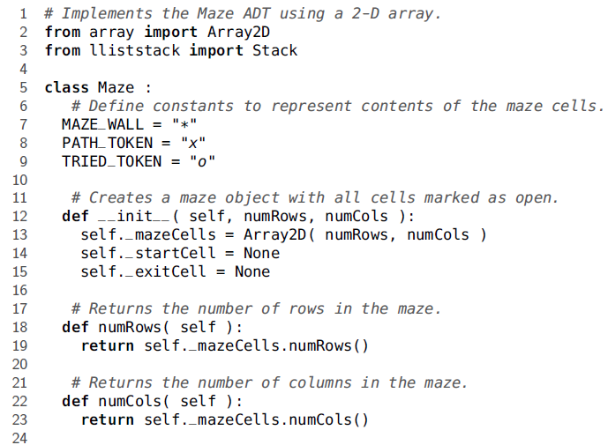
Maze - Code

Slide 37
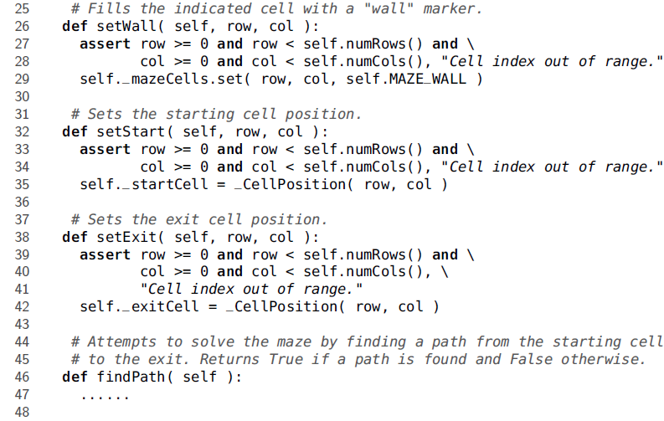
Maze - Code

Slide 38
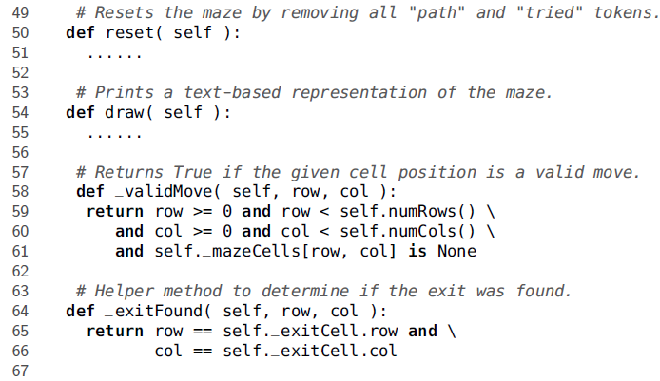
Maze - Code

Slide 39
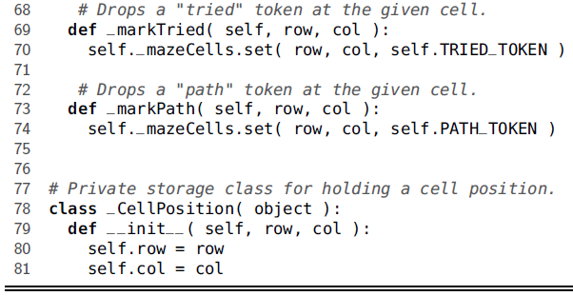
Maze - Code

Slide 40
Maze – Code – FindPath() function
def findPath(self): s = Stack()#stack to save the path s.push(self._startCell) self._markPath(self._startCell.row, self._startCell.col) while True: #inside the loop where neighbor cell is checked for valid move #same time, checked if we get the exit if s.isEmpty(): return False current_cell = s.peek() row = current_cell.row col = current_cell.col if not self._exitFound(row, col): for r in [row-1, row, row+1]: if not (current_cell.row == s.peek().row and \ current_cell.col == s.peek().col): break | for c in [col-1, col, col+1]: if ((r == row) ^ (c == col)): if self._validMove(r,c): self._markPath(r,c) s.push(_CellPosition(r,c)) break if current_cell.row == s.peek().row and\ current_cell.col == s.peek().col: not_in_path = s.pop() self._markTried(not_in_path.row, not_in_path.col) else: return True

Slide 41
Maze – Code – reset() function
def reset(self): for r in range(self.numRows()): for c in range(self.numCols()): if self._mazeCells[r,c] == self.PATH_TOKEN or \ self._mazeCells[r,c] == self.TRIED_TOKEN: self._mazeCells.clear()

Slide 42
Maze – Code – draw() function
def draw(self): for r in range(self.numRows()): for c in range(self.numCols()): if self._mazeCells[r,c] is not None: print(self._mazeCells[r,c], sep = ' ', end= ' ') else: if self._startCell.row == r and self._startCell.col == c: print('s', sep = ' ', end = ' ') elif self._exitCell.row == r and self._exitCell.col == c: print('e', sep = ' ', end = ' ') else: print('.', sep = ' ', end = ' ') print ('\n') print ("--------------------------")

